Slide 1
Chapter 2 – Software Processes
Anh Nguyen-Duc
Tho Quan Thanh

Slide 2
Topics covered
Software process models
Process activities
Coping with change
Process improvement
Menti + Breakout room for discussion

Slide 3
What is your understanding of a “Software Process”?
Have you used any “Software Process Model” in your practice?
Which models?
Examples?
Uses? Strengths/Weaknesses?
Observations?

Slide 4
Software Engineering – for Orientation
Software Engineering is a branch of systems engineering concerned with the development of large and complex software intensive systems. It focuses on:
the real-world goals for, services provided by, and constraints on such systems,
the precise specification of systems structure and behaviour, and the implementations of these specifications,
the activities required in order to develop an assurance that the specifications and real world-world goals have been met,
the evolution of these systems over time, and across systems families,
It is also concerned with the processes, methods and tools for the development of software intensive systems in an economic and timely manner.
Reference: A. Finkelstein

Slide 5
The software process
A structured set of activities required to develop a software system.
Many different software processes but all involve:
Specification
Design and implementation
Validation
Evolution.
A software process model
an abstract representation of a process
Notes:
Software process
A software process is a structured set of activities required to develop a software system.
There are many different software processes but all involve:
Specification – defining what the system should do;
Design and implementation – defining the organization of the system and implementing the system;
Validation – checking that it does what the customer wants;
Evolution – changing the system in response to changing customer needs.
A software process model is an abstract representation of a process. It presents a description of a process from some particular perspective.
Software process descriptions
Processes:
about the activities in these processes: specifying a data model, designing a user interface, etc. and the ordering of these activities.
Process descriptions may also include:
Products, which are the outcomes of a process activity;
Roles, which reflect the responsibilities of the people involved in the process;
Pre- and post-conditions, which are statements that are true before and after a process activity has been enacted or a product produced.

Slide 6
Some software process models
The waterfall model
Plan-driven model.
Separate and distinct phases of specification and development.
Incremental development
Specification, development and validation are interleaved.
May be plan-driven or agile.
Integration and configuration
The system is assembled from existing configurable components.
May be plan-driven or agile.
In practice, most large systems are developed using a process that incorporates elements from all of these models.
Notes:
Plan-driven and agile processes
Plan-driven processes are processes where all of the process activities are planned in advance and progress is measured against this plan.
In agile processes, planning is incremental and it is easier to change the process to reflect changing customer requirements.
In practice, most practical processes include elements of both plan-driven and agile approaches.
There are no right or wrong software processes.

Slide 7
The waterfall model
In principle, a phase has to be complete before moving onto the next phase.
Notes:
There are separate identified phases in the waterfall model:
Requirements analysis and definition
System and software design
Implementation and unit testing
Integration and system testing
Operation and maintenance
Alternatives?

Slide 8
Waterfall model usages
The main drawback:
the difficulty of accommodating change after the process is underway.
Mostly used for large systems engineering projects
a system is developed at several sites.
the plan-driven nature of the waterfall model helps coordinate the work.
When the requirements are well-understood and changes will be fairly limited during the design process.
Few business systems have stable requirements.
Notes:
The waterfall model is mostly used for large systems engineering projects where a system is developed at several sites.
In those circumstances, the plan-driven nature of the waterfall model helps coordinate the work.
Inflexible partitioning of the project into distinct stages makes it difficult to respond to changing customer requirements.
Therefore, this model is only appropriate when the requirements are well-understood and changes will be fairly limited during the design process.
Few business systems have stable requirements.

Slide 9
Incremental development

Slide 10
Incremental development benefits
Reduce the cost of accommodating changing customer requirements
Easier to get customer feedback on the development work that has been done.
More rapid delivery and deployment of useful software to the customer
Notes:
The cost of accommodating changing customer requirements is reduced.
The amount of analysis and documentation that has to be redone is much less than is required with the waterfall model.
It is easier to get customer feedback on the development work that has been done.
Customers can comment on demonstrations of the software and see how much has been implemented.
More rapid delivery and deployment of useful software to the customer is possible.
Customers are able to use and gain value from the software earlier than is possible with a waterfall process.

Slide 11
Incremental development problems
The process is not visible.
Managers need regular deliverables
Not cost-effective to produce documents for every product version
System structure tends to degrade as new increments are added.
Need time and money on refactoring to improve the software
Regular change tends to corrupt the structure.
Incorporating further software changes becomes increasingly difficult and costly.
Notes:
The process is not visible.
Managers need regular deliverables to measure progress.
If systems are developed quickly, it is not cost-effective to produce documents that reflect every version of the system.
System structure tends to degrade as new increments are added.
Unless time and money is spent on refactoring to improve the software, regular change tends to corrupt its structure.
Incorporating further software changes becomes increasingly difficult and costly.

Slide 12
agile development
i.e.: waterfall model, incremental development
Notes:
Plan-driven development
A plan-driven approach to software engineering is based around separate development stages with the outputs to be produced at each of these stages planned in advance.
Not necessarily waterfall model – plan-driven, incremental development is possible
Iteration occurs within activities.
Agile development
Specification, design, implementation and testing are inter-leaved and the outputs from the development process are decided through a process of negotiation during the software development process.

Slide 13
agile development
i.e.: waterfall model, incremental development
Notes:
Plan-driven development
A plan-driven approach to software engineering is based around separate development stages with the outputs to be produced at each of these stages planned in advance.
Not necessarily waterfall model – plan-driven, incremental development is possible
Iteration occurs within activities.
Agile development
Specification, design, implementation and testing are inter-leaved and the outputs from the development process are decided through a process of negotiation during the software development process.

Slide 14
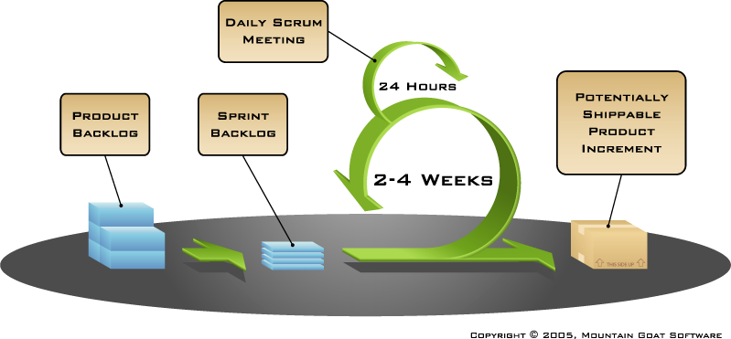
SCRUM – THE MOST POPULAR AGILE DEVELOPMENT APPROACHES

Slide 15
AGILE DEVELOPMENT
PROs | CONs
More flexible | Hard to predict
Product get to market faster | Final product is not released first
Better communication | Documentation gets left behind

Slide 16
Reuse-oriented software engineering
Based on software reuse where systems are integrated from existing components or application systems (COTS -Commercial-off-the-shelf) systems).
Stand-alone application systems (COTS)
Package objects / component framework such as .NET or J2EE.
Web services
Reused elements may be configured to adapt their behaviour and functionality to a user’s requirements
Reuse is now the standard approach for building many types of business system
Notes:
Types of reusable software
Stand-alone application systems (sometimes called COTS) that are configured for use in a particular environment.
Collections of objects that are developed as a package to be integrated with a component framework such as .NET or J2EE.
Web services that are developed according to service standards and which are available for remote invocation.

Slide 17
Reuse-oriented software engineering
Notes:
Reuse is now the standard approach for building many types of business system
Process stages:
Requirements specification
Software discovery and evaluation
Requirements refinement
Application system configuration
Component adaptation and integration

Slide 18
Advantages and disadvantages
Reduced costs and risks as less software is developed from scratch
Faster delivery and deployment of system
But requirements compromises are inevitable so system may not meet real needs of users
Loss of control over evolution of reused system elements

Slide 19
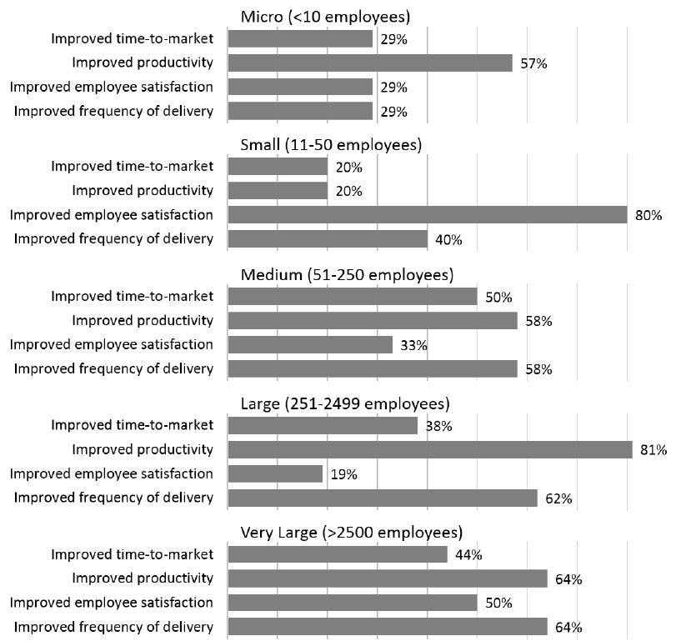
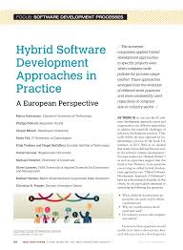
“Hybrid dEveLopmENt Approaches in software systems development” (HELENA)
Many companies face the problem of selecting a suitable development approach fitting to their specific context
Kuhrmann, M., P. Diebold, J. Munch, P. Tell, K. Trektere, F. McCaffery, V. Garousi, et al. 2019. “Hybrid Software Development Approaches in Practice: A European Perspective.” IEEE Software 36 (4): 20–31. https://doi.org/10.1109/MS.2018.110161245.

Slide 20
A DISCUSSION CASE
https://docs.google.com/document/d/1S05m-iNqgjqhPTAkPJM6FfoXdnmv6EO4q_drPjeXqTA/edit?usp=sharing

Slide 21
Process activities
Notes:
Real software processes are inter-leaved sequences of technical, collaborative and managerial activities with the overall goal of specifying, designing, implementing and testing a software system.
The four basic process activities of specification, development, validation and evolution are organized differently in different development processes. In the waterfall model, they are organized in sequence, whereas in incremental development they are inter-leaved.

Slide 22
Process Activities
Real software processes are inter-leaved sequences of technical, collaborative and managerial activities with the overall goal of specifying, designing, implementing and testing a software system.
The four basic process activities (specified in your book) of specification, development, validation and evolution are organized differently in different development processes.
In the waterfall model, they are organized in sequence, whereas in incremental development they are inter-leaved.
16

Slide 23
Activity: Software specification
The process of establishing what services are required and the constraints on the system’s operation and development.
Feasibility study
Use: Requirements engineering process
Requirements elicitation and analysis
Requirements specification
Requirements validation
Notes:
Requirements engineering process
Requirements elicitation and analysis
What do the system stakeholders require or expect from the system?
Requirements specification
Defining the requirements in detail
Requirements validation
Checking the validity of the requirements

Slide 24
The requirements engineering process
Notes:
Requirements elicitation and analysis
What do the system stakeholders require or expect from the system?
Generate the System models
Requirements specification
Defining the requirements in detail
Generate the User and System requirements
Requirements validation
Checking the validity of the requirements
Generate the Requirement document from System models and User and system requirements

Slide 25
Activity: Software design and implementation ~ Software development
The process of converting the system specification into an executable system.
Two (sub) activities:
Software design
Design a software structure that realises the specification;
Implementation
Translate this structure into an executable program;
The activities of design and implementation are closely related and may be inter-leaved.

Slide 26
A general model of the design process
Notes:
A general model of the design process
Inputs:
Platform information
Requirements specification
Data description
Activities:
Architectural design, where you identify the overall structure of the system, the principal components (sometimes called sub-systems or modules), their relationships and how they are distributed.
Interface design, where you define the interfaces between system components.
Component design, where you take each system component and design how it will operate.
Database design, where you design the system data structures and how these are to be represented in a database.
Outputs:
System architecture
Database specification
Interface specification
Component specification

Slide 27
System implementation
The software is implemented either by developing a program or programs or by configuring an application system.
Design and implementation are interleaved activities for most types of software system.
Programming is an individual activity with no standard process.
Debugging is the activity of finding program faults and correcting these faults.

Slide 28
Activity: Software validation
building the thing right?
Verification and validation (V & V)
to show that a system conforms to its specification and meets the requirements of the system customer.
Involves checking and review processes and system testing.
System testing: executing the system with test cases
Testing: the most commonly used V & V activity.
building the right thing?
Notes:
Verification and validation (V & V) is intended to show that a system conforms to its specification and meets the requirements of the system customer.
Involves checking and review processes and system testing.
System testing involves executing the system with test cases that are derived from the specification of the real data to be processed by the system.
Testing is the most commonly used V & V activity.
Meaning of V & V:
Verification:
are we building the thing right?
Validation:
are we building the right thing?

Slide 29
Stages of testing
Test individual components independently
Testing of the system as a whole
Testing with customer data
Notes:
States of testing
Development or component testing
Individual components are tested independently;
Components may be functions or objects or coherent groupings of these entities.
System testing
Testing of the system as a whole. Testing of emergent properties is particularly important.
Acceptance testing
Testing with customer data to check that the system meets the customer’s needs.

Slide 30
Testing phases in a plan-driven software process

Slide 31
Activity: Software evolution
Software is inherently flexible and can change.
Requirements can change
(changing business circumstances) => the software must also evolve and change.
Notes:
Although there has been a demarcation between development and evolution (maintenance) this is increasingly irrelevant as fewer and fewer systems are completely new.

Slide 32
Coping with change

Slide 33
Coping with change
Change is inevitable in all large software projects.
Business changes
New technologies
Changing platforms
Change leads to rework
costs include rework (re-analysing requirements) and implementing new functionality
Notes:
Change is inevitable in all large software projects.
Business changes lead to new and changed system requirements
New technologies open up new possibilities for improving implementations
Changing platforms require application changes
Change leads to rework so the costs of change include both rework (e.g. re-analysing requirements) as well as the costs of implementing new functionality
Reducing the costs of rework
Change avoidance, where the software process includes activities that can anticipate possible changes before significant rework is required.
For example, a prototype system may be developed to show some key features of the system to customers.
Change tolerance, where the process is designed so that changes can be accommodated at relatively low cost.
This normally involves some form of incremental development. Proposed changes may be implemented in increments that have not yet been developed. If this is impossible, then only a single increment (a small part of the system) may have be altered to incorporate the change.

Slide 34
Software prototyping
A prototype is an initial version of a system used to demonstrate concepts and try out design options.
A prototype can be used in:
requirements engineering process: requirements elicitation and validation;
design processes: options and develop UI design;
testing process: run back-to-back tests.
Benefits:
Improved system usability.
A closer match to users’ real needs.
Improved design quality.
Improved maintainability.
Reduced development effort.
Notes:
A prototype can be used in:
The requirements engineering process to help with requirements elicitation and validation;
In design processes to explore options and develop a UI design;
In the testing process to run back-to-back tests.
Benefit of software prototyping:
Improved system usability.
A closer match to users’ real needs.
Improved design quality.
Improved maintainability.
Reduced development effort.

Slide 35
The process of prototype development
Prototype development:
May be based on rapid prototyping languages or tools
May involve leaving out functionality
Notes:
Prototype development
May be based on rapid prototyping languages or tools
May involve leaving out functionality
Prototype should focus on areas of the product that are not well-understood;
Error checking and recovery may not be included in the prototype;
Focus on functional rather than non-functional requirements such as reliability and security
Prototypes should be discarded after development as they are not a good basis for a production system:
It may be impossible to tune the system to meet non-functional requirements;
Prototypes are normally undocumented;
The prototype structure is usually degraded through rapid change;
The prototype probably will not meet normal organisational quality standards.

Slide 36
Incremental delivery
The development and delivery is broken down into increments
each increment delivering part of the required functionality.
user requirements are prioritised and the highest priority requirements are included in early increments.
Two approaches:
Incremental development: by developer
Incremental delivery: for end-user
Notes:
Incremental delivery
Rather than deliver the system as a single delivery, the development and delivery is broken down into increments with each increment delivering part of the required functionality.
User requirements are prioritised and the highest priority requirements are included in early increments.
Once the development of an increment is started, the requirements are frozen though requirements for later increments can continue to evolve.
Incremental development
Develop the system in increments and evaluate each increment before proceeding to the development of the next increment;
Normal approach used in agile methods;
Evaluation done by user/customer proxy.
Incremental delivery
Deploy an increment for use by end-users;
More realistic evaluation about practical use of software;
Difficult to implement for replacement systems as increments have less functionality than the system being replaced.

Slide 37
Incremental delivery
Advantages:
system functionality is available earlier.
early increments act as a prototype
lower risk of overall project failure.
highest priority system services receive most testing.
Problems:
may require a set of basic facilities
the specification is developed in conjunction with the software.
Notes:
Incremental delivery advantages:
Customer value can be delivered with each increment so system functionality is available earlier.
Early increments act as a prototype to help elicit requirements for later increments.
Lower risk of overall project failure.
The highest priority system services tend to receive the most testing.
Incremental delivery problems:
Most systems require a set of basic facilities that are used by different parts of the system.
As requirements are not defined in detail until an increment is to be implemented, it can be hard to identify common facilities that are needed by all increments.
The essence of iterative processes is that the specification is developed in conjunction with the software.
However, this conflicts with the procurement model of many organizations, where the complete system specification is part of the system development contract.

Slide 38
Process improvement

Slide 39
Process improvement
Software process improvement
enhancing the quality of software,
reducing costs
or accelerating development processes.
Process improvement
understanding existing processes
and changing these processes
Notes:
Many software companies have turned to software process improvement as a way of enhancing the quality of their software, reducing costs or accelerating their development processes.
Process improvement means understanding existing processes and changing these processes to increase product quality and/or reduce costs and development time.
The process maturity approach, which focuses on improving process and project management and introducing good software engineering practice.
The level of process maturity reflects the extent to which good technical and management practice has been adopted in organizational software development processes.
The agile approach, which focuses on iterative development and the reduction of overheads in the software process.
The primary characteristics of agile methods are rapid delivery of functionality and responsiveness to changing customer requirements.

Slide 40
Process improvement activities
Process measurement
You measure one or more attributes of the software process or product. These measurements forms a baseline that helps you decide if process improvements have been effective.
Process analysis
The current process is assessed, and process weaknesses and bottlenecks are identified. Process models (sometimes called process maps) that describe the process may be developed.
Process change
Process changes are proposed to address some of the identified process weaknesses. These are introduced and the cycle resumes to collect data about the effectiveness of the changes.
Notes:
Process measurement
Wherever possible, quantitative process data should be collected
However, where organisations do not have clearly defined process standards this is very difficult as you don’t know what to measure. A process may have to be defined before any measurement is possible.
Process measurements should be used to assess process improvements
But this does not mean that measurements should drive the improvements. The improvement driver should be the organizational objectives.
Process metrics
Time taken for process activities to be completed
E.g. Calendar time or effort to complete an activity or process.
Resources required for processes or activities
E.g. Total effort in person-days.
Number of occurrences of a particular event
E.g. Number of defects discovered.

Slide 41
The Capability Maturity Model (CMM)
Capability Maturity Model Integration (CMMI) is a process level improvement training and appraisal program
CMMI defines the most important elements that are required to build great products, or deliver great service
It is required by many U.S. Government contracts, especially in software development.
Notes:
Process measurement
Wherever possible, quantitative process data should be collected
However, where organisations do not have clearly defined process standards this is very difficult as you don’t know what to measure. A process may have to be defined before any measurement is possible.
Process measurements should be used to assess process improvements
But this does not mean that measurements should drive the improvements. The improvement driver should be the organizational objectives.
Process metrics
Time taken for process activities to be completed
E.g. Calendar time or effort to complete an activity or process.
Resources required for processes or activities
E.g. Total effort in person-days.
Number of occurrences of a particular event
E.g. Number of defects discovered.

Slide 42
The Capability Maturity Model (CMM)
Process improvement strategies defined and used
Quality management strategies defined and used
Process management procedures and strategies defined and used
Product management procedures defined and used
Essentially uncontrolled
http://en.wikipedia.org/wiki/Capability_Maturity_Model_Integration
Notes:
Level 1 – Initial
It is characteristic of processes at this level that they are (typically) undocumented and in a state of dynamic change, tending to be driven in an ad hoc, uncontrolled and reactive manner by users or events. This provides a chaotic or unstable environment for the processes. (Example - a surgeon performing a new operation a small number of times - the levels of negative outcome are not known).
Level 2 – Repeatable
It is characteristic of this level of maturity that some processes are repeatable, possibly with consistent results. Process discipline is unlikely to be rigorous, but where it exists it may help to ensure that existing processes are maintained during times of stress.
Level 3 – Defined
It is characteristic of processes at this level that there are sets of defined and documented standard processes established and subject to some degree of improvement over time. These standard processes are in place. The processes may not have been systematically or repeatedly utilised - sufficient for the users to become competent or the process to be validated in a range of situations. This could be considered a developmental stage - with use in a wider range of conditions and user competence development the process can develop to next level of maturity.
Level 4 - Managed (Capable)
It is characteristic of processes at this level that, using process metrics, effective achievement of the process objectives can be evidenced across a range of operational conditions. The suitability of the process in multiple environments has been tested and the process refined and adapted. Process users have experienced the process in multiple and varied conditions, and are able to demonstrate competence. The process maturity enables adaptions to particular projects without measurable losses of quality or deviations from specifications. Process Capability is established from this level. (Example - surgeon performing an operation 100's of times with levels of negative outcome approaching zero).
Level 5 – Optimizing
It is a characteristic of processes at this level that the focus is on continually improving process performance through both incremental and innovative technological changes/improvements.
At maturity level 5, processes are concerned with addressing statistical common causes of process variation and changing the process (for example, to shift the mean of the process performance) to improve process performance. This would be done at the same time as maintaining the likelihood of achieving the established quantitative process-improvement objectives. There are only a few companies in the world that have attained this level 5.[citation needed].

Slide 43
Software Project Documentation
Activity | Document
Validation & Verification | SVVP - Software Validation & Verification Plan
Quality Assurance | SQAP - Software Quality Assurance Plan
Configuration | SCMP - Software Configuration Management Plan
Project status | SPMP - Software Project Management Plan
Requirements | SRS - Software Requirements Specifications
Design | SDD - Software Design Document / Software Detail Design Document
Code | Source Code
Testing | STD - Software Test Document
Operation | User’s Manual

Slide 44
Summary
Software processes
Software process models
waterfall, incremental development, reuse-oriented development.
Fundamental activities:
Requirements engineering: developing specification.
Design and implementation: transforming a requirements specification into an executable software system
Software validation: checking that the system conforms to its specification.
Software evolution: change existing software systems to meet new requirements
Notes:
Software processes are the activities involved in producing a software system. Software process models are abstract representations of these processes.
General process models describe the organization of software processes. Examples of these general models include the ‘waterfall’ model, incremental development, and reuse-oriented development.
Requirements engineering is the process of developing a software specification.
Design and implementation processes are concerned with transforming a requirements specification into an executable software system.
Software validation is the process of checking that the system conforms to its specification and that it meets the real needs of the users of the system.
Software evolution takes place when you change existing software systems to meet new requirements. The software must evolve to remain useful.
Processes should include activities to cope with change. This may involve a prototyping phase that helps avoid poor decisions on requirements and design.
Processes may be structured for iterative development and delivery so that changes may be made without disrupting the system as a whole.
The Rational Unified Process is a modern generic process model that is organized into phases (inception, elaboration, construction and transition) but separates activities (requirements, analysis and design, etc.) from these phases.

Slide 45
Summary (cont.)
Coping with change
prototyping
iterative development and delivery
Process improvement
agile approaches, geared to reducing process overheads,
maturity-based approaches based on better process management
and the use of good software engineering practice.
The SEI process maturity framework (CMM)
identifies maturity levels that essentially correspond to the use of good software engineering practice.
Notes:
Processes should include activities to cope with change. This may involve a prototyping phase that helps avoid poor decisions on requirements and design.
Processes may be structured for iterative development and delivery so that changes may be made without disrupting the system as a whole.
The Rational Unified Process is a modern generic process model that is organized into phases (inception, elaboration, construction and transition) but separates activities (requirements, analysis and design, etc.) from these phases.

